Slide 1
K-Means Clustering
K-Means Clustering groups similar data points into clusters without needing labeled data. It is used to uncover hidden patterns when the goal is to organize data based on similarity.
Helps identify natural groupings in unlabeled datasets
Works by grouping points based on distance to cluster centers
Commonly used in customer segmentation, image compression, and pattern discovery
Useful when you need structure from raw, unorganized data
The vast majority of the instances were clearly assigned to the appropriate cluster, but a few instances were probably mislabeled (especially near the boundary between the top-left cluster and the central cluster).
Indeed, the K-Means algorithm does not behave very well when the blobs have very different diameters because all it cares about when assigning an instance to a cluster is the distance to the centroid.

Slide 2
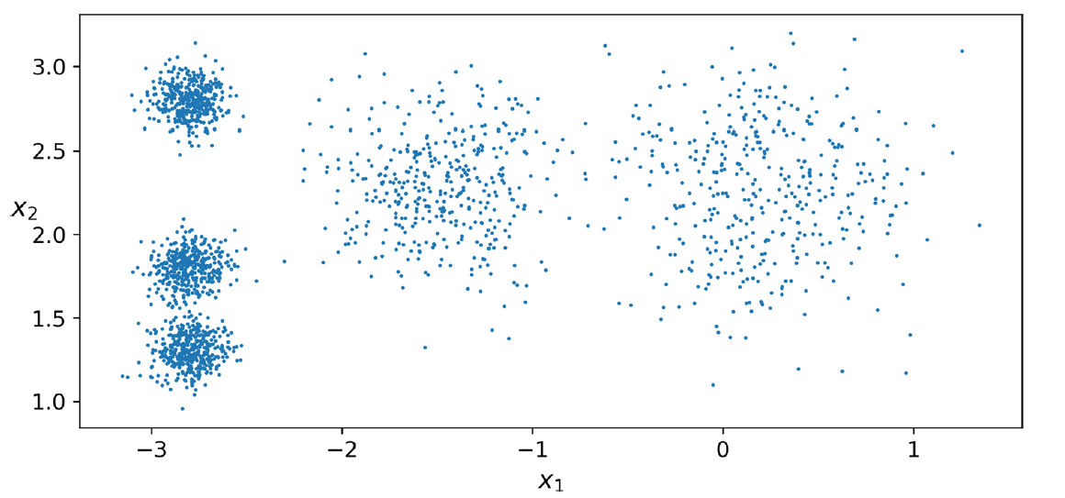
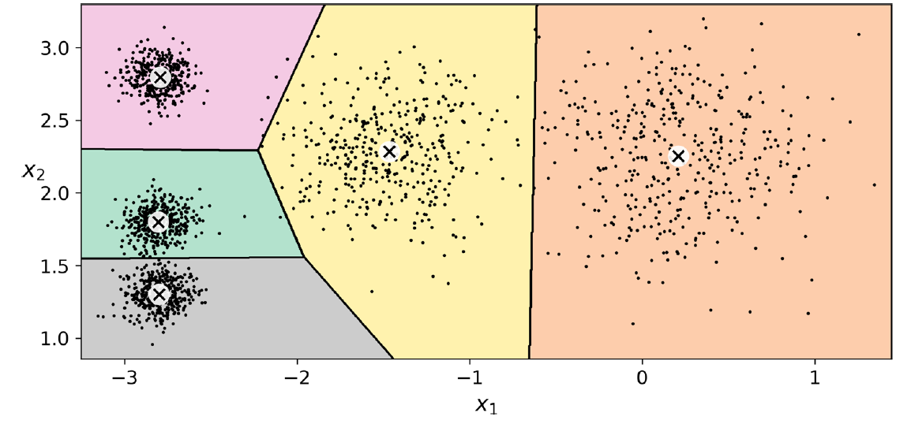
K-Means Clustering

Slide 3
K-means clustering
Instead of assigning each instance to a single cluster, which is called hard clustering, it can be useful to give each instance a score per cluster, which is called soft clustering.
The score can be the distance between the instance and the centroid; conversely, it can be a similarity score (or affinity), such as the Gaussian Radial Basis Function.
The computational complexity of the algorithm is generally linear with regard to the number of instances m, the number of clusters k, and the number of dimensions n. However, this is only true when the data has a clustering structure. If it does not, then in the worstcase scenario the complexity can increase exponentially with the number of instances. In practice, this rarely happens, and K-Means is generally one of the fastest clustering algorithms.

Slide 5
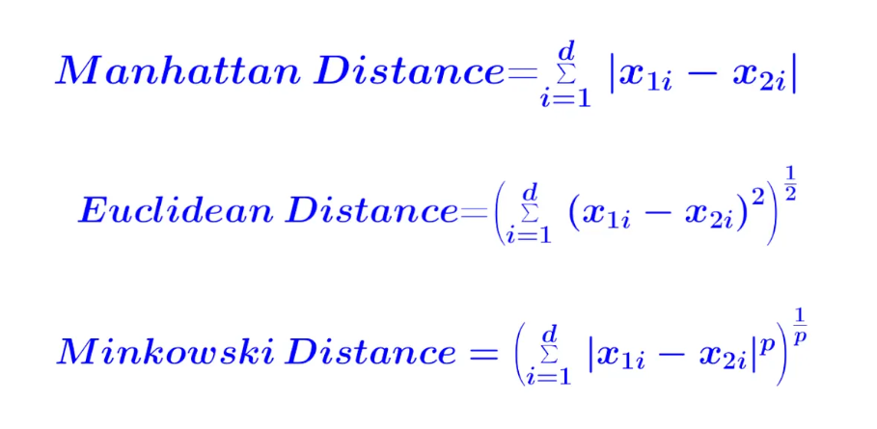
Dissimilarity(or distance) measure d(x,y)
Manhattan distance
Euclidean distance
Minkowski Distances

Slide 6
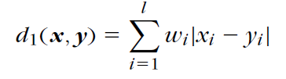
Manhattan distance
Special lp metric DMs that are also encountered in practice are the (weighted) l1 or Manhattan norm,

Slide 7
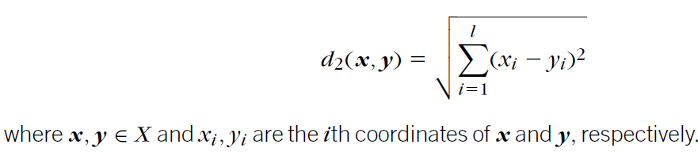
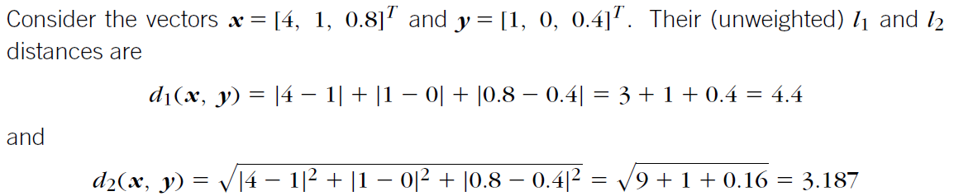
Euclidean distance
This is a dissimilarity measure on X, with d₀ = 0; that is, the minimum possible distance between two vectors of X is 0. Moreover, the distance of a vector from itself is equal to 0. Also, it is easy to observe that d(x, y) d( y, x).

Slide 8
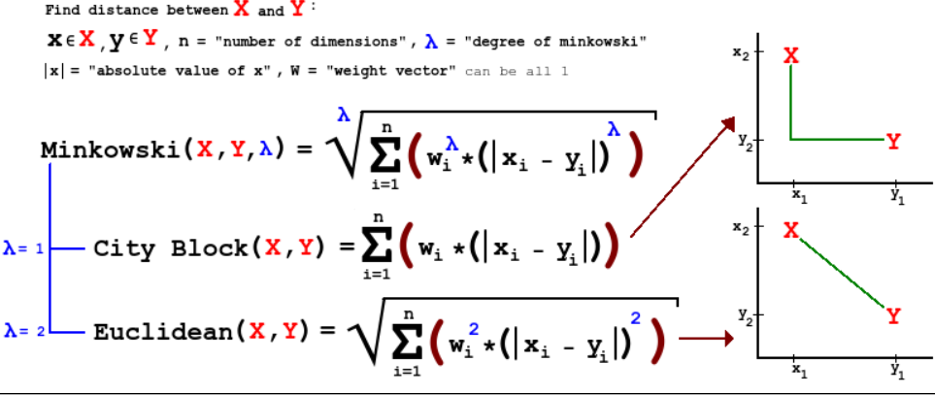
Minkowski Distances

Slide 9
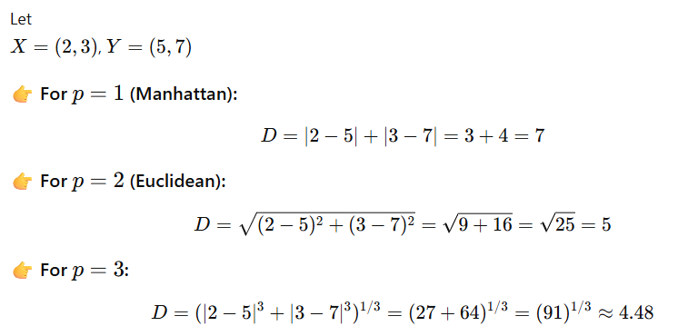
Dissimilarity(or distance) measure d(x,y)

Slide 10
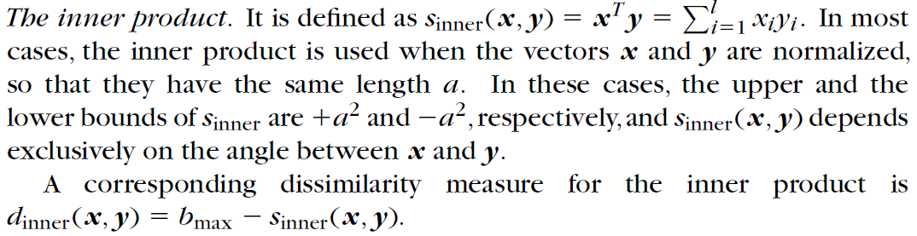
Similarity measure s(x,y)

Slide 11
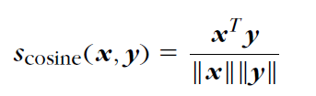
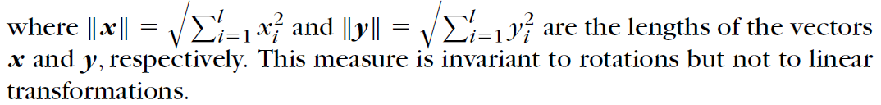
Cosine Similarity
Closely related to the inner product is the cosine similarity measure, which is defined as

Slide 12
Steps in K-means clustering algorithm
Choose Number of Clusters (K)
Select the number of clusters K based on the problem requirement.
Methods like the Elbow Method can help in choosing optimal K.
Initializing Random Centroids
Randomly select K data points as the initial cluster centroids.
These centroids represent the center of each cluster.
Assign Data Points to Nearest Centroid
For each data point, compute the distance (usually Euclidean distance) from all centroids.
Assign each point to the cluster with the minimum distance.

Slide 13

Steps in K-means clustering algorithm
Update Centroids
Recalculate the centroid of each cluster by taking the mean of all points assigned to that cluster.
Check for Convergence
Compare old and new centroids.
If centroids do not change (or change is below a threshold), the algorithm stops.
Otherwise, repeat Steps 3 and 4.

Slide 14

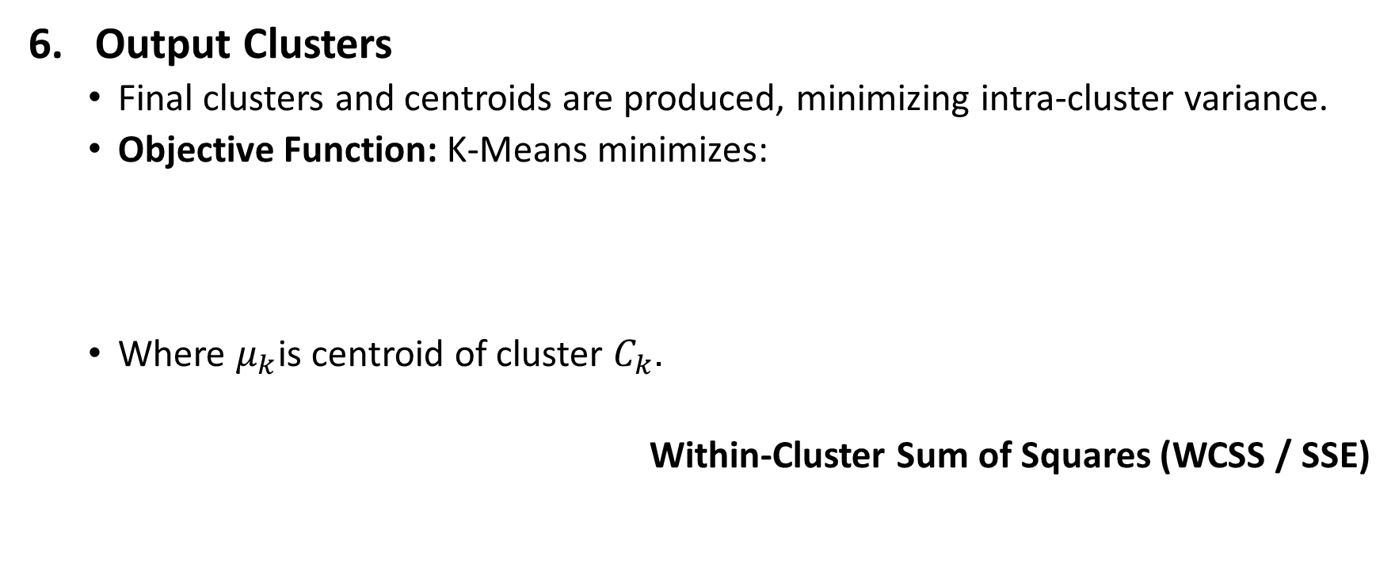
Steps in K-means clustering algorithm
Output Clusters
Final clusters and centroids are produced, minimizing intra-cluster variance.
Objective Function: K-Means minimizes:
Where $μ_{k}$is centroid of cluster $C_{k}$.
Within-Cluster Sum of Squares (WCSS / SSE)

Slide 15
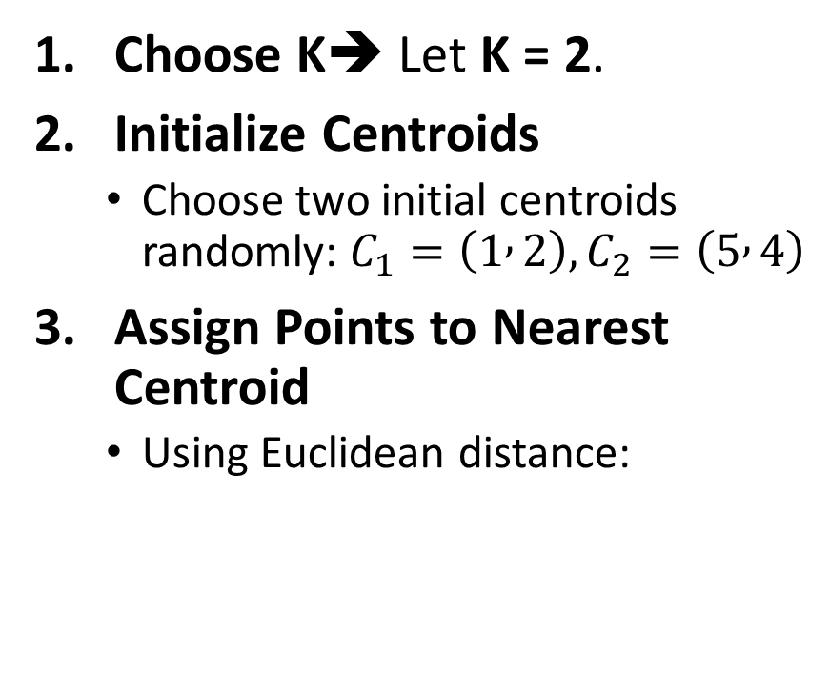
Simple Example of K-Means Clustering
Assume we have 6 data points representing students based on two features: Study Hours (X) and Marks (Y).
Choose K➔ Let K = 2.
Initialize Centroids
Choose two initial centroids randomly: $C_{1}=\left(1 , 2\right), C_{2}=\left(5 , 4\right)$
Assign Points to Nearest Centroid
Using Euclidean distance:
Student | X (Hours) | Y (Marks)
A | 1 | 2
B | 2 | 1
C | 4 | 5
D | 5 | 4
E | 6 | 5
F | 7 | 6

Slide 16
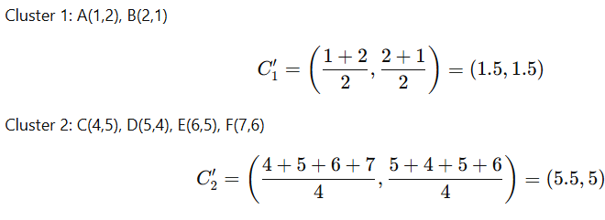


Simple Example of K-Means Clustering
Assign Points to Nearest Centroid
Using Euclidean distance:
Update Centroids
$$C_{1}=\left(1 , 2\right), C_{2}=\left(5 , 4\right)$$
Point | Dist to C₁ | Dist to C₂ | Cluster
A(1,2) | 0 | 4.47 | C₁
B(2,1) | 1.41 | 4.24 | C₁
C(4,5) | 4.24 | 1.41 | C₂
D(5,4) | 4.47 | 0 | C₂
E(6,5) | 5.66 | 1.41 | C₂
F(7,6) | 7.21 | 2.83 | C₂
Cluster 1 → A, B, Cluster 2 → C, D, E, F

Slide 17
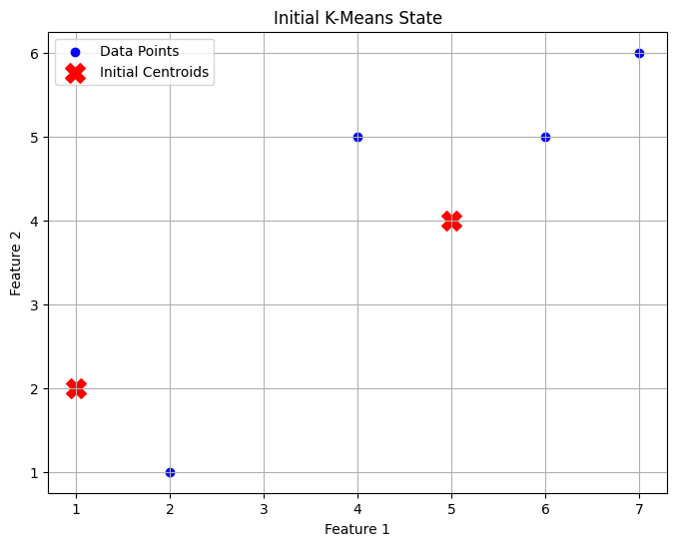
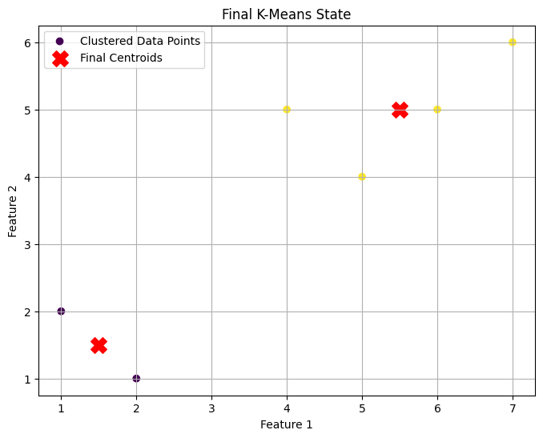
Simple Example of K-Means Clustering

Slide 18
Simple Example of K-Means Clustering
Repeat Step 3, 4
Assign Points to Nearest Centroid
Using Euclidean distance:
Update Centroids
$$C_{1}=\left(1.5 , 1.5\right), C_{2}=\left(5.5 , 5\right)$$
Point | d to C₁ | d to C₂ | Assigned Cluster
A | 0.71 | 5.41 | C₁
B | 0.71 | 5.32 | C₁
C | 4.30 | 1.50 | C₂
D | 4.30 | 1.12 | C₂
E | 5.70 | 0.50 | C₂
F | 7.11 | 1.80 | C₂
Cluster 1 → A, B, Cluster 2 → C, D, E, F

Slide 19
Limitations of k means clustering
K-means clustering needs the number of clusters to be specified.
K-means has problems when clusters are of differing sized, densities, and nonglobular shapes.
Presence of outlier can skew the results.

Slide 20
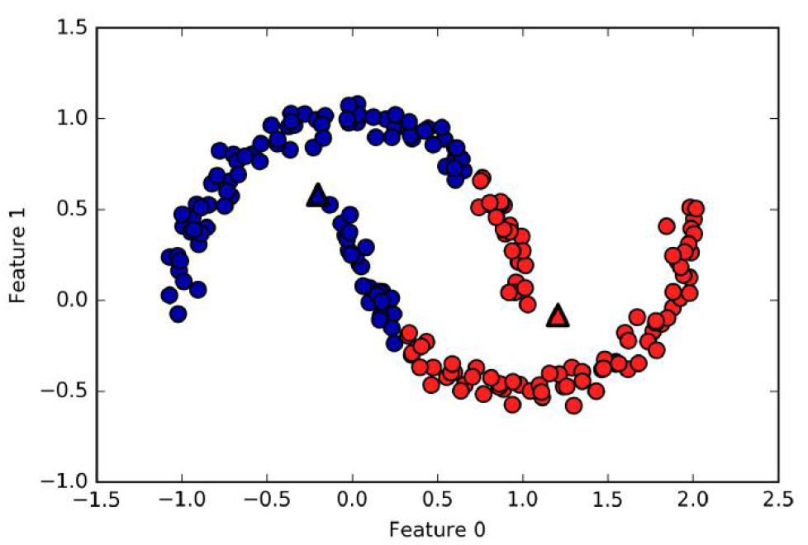
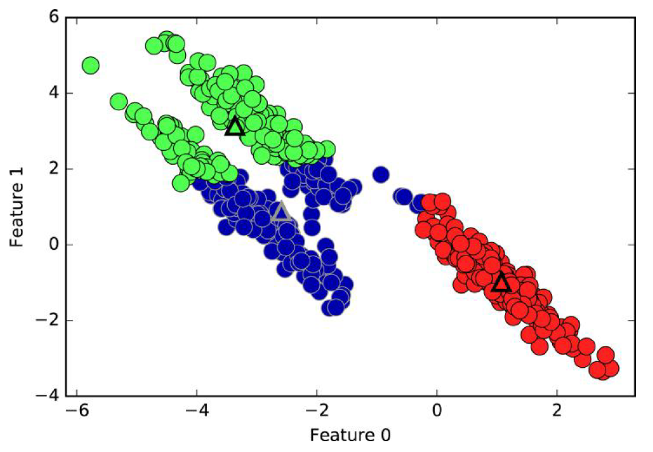
Failure cases of k-means
k-means fails to identify nonspherical clusters
k-means fails to identify clusters with complex shapes

Slide 21
Use cases
K-Means is widely used for many applications.
Image Segmentation
Clustering Gene Segmentation Data
News Article Clustering
Clustering Languages
Species Clustering
Anomaly Detection

Slide 22

Elbow Method
First of all, compute the sum of squared error (SSE) for some values of k. The SSE is defined as the sum of the squared distance between each member of the cluster and its centroid. Mathematically:
If you plot k against the SSE, you will see that the error decreases as k gets larger; this is because when the number of clusters increases, they should be smaller, so distortion is also smaller. The idea of the elbow method is to choose the k at which the SSE decreases abruptly. This produces an "elbow effect" in the graph

Slide 23
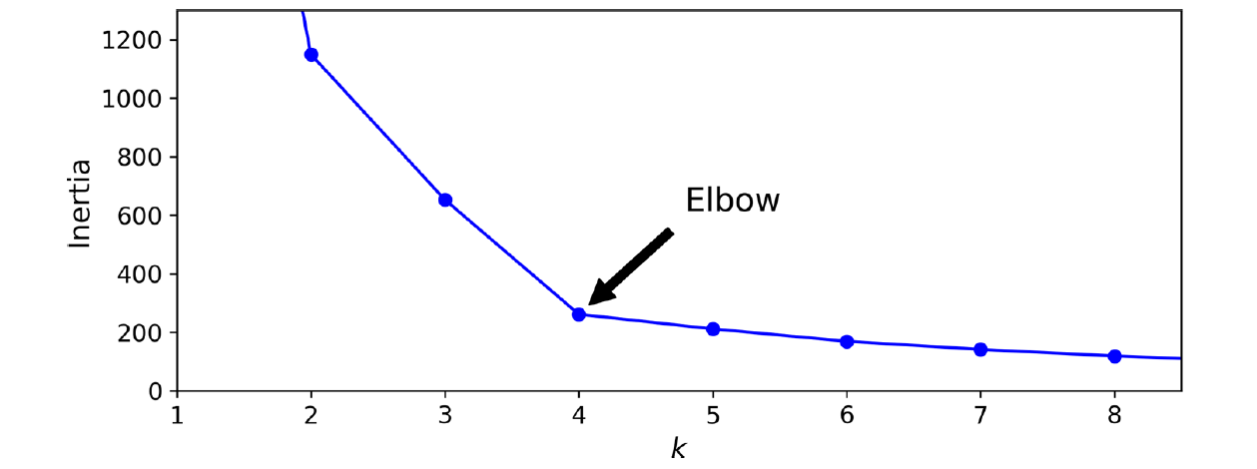
Elbow Method

